Slide 1





At Debt's Door Game Design Document
Edison Cai - 20241135
Sergiu Mereacre - 20238029
Bayan Nezamabad - 20251971
Jack O’Brien - 20245777
z

Slide 2
Table of Contents
Introduction/Overview 3-8
Story Summarised 4
Story In-Depth 5
Features That Make The Game Compelling And Unique 6-8
Controls During Play 9
Game Mechanics 10-11
Game Mechanics – Summary 11
Game AI 12-19
Passive AI 13-16
Aggressive AI 17-19
Game Elements 20-43
Game Progression 44-46
Win Loss Conditions 47
System Menus 48-51
Main Menu 49
Loadout Screen 50
Map Selection Screen 51
Game Design Plan 52-56
Production Plan Visual Representation 56
Postproduction 57-59
Trailers 58
Sponsorships 59
Conclusion 60
References 61

Slide 3
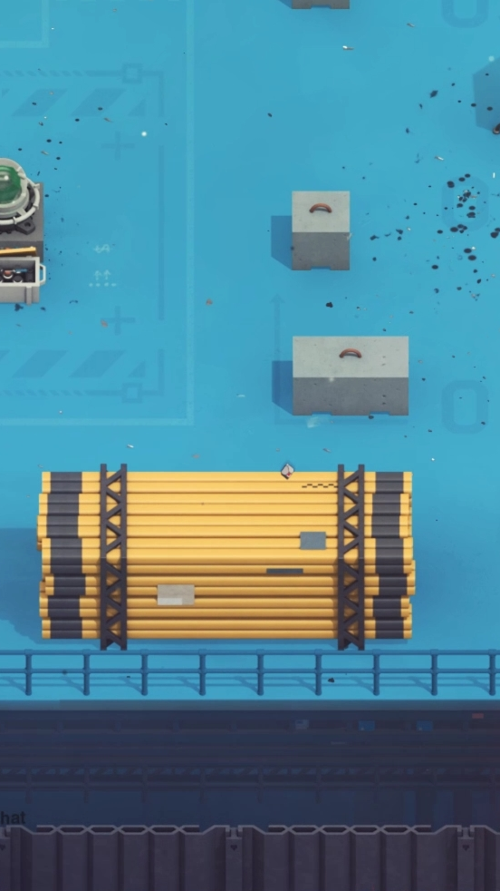
Introduction/ Overview
At Debt’s Door (or A.D.D.) is a fast-paced shooter/strategy game for the PC platform. The goal of the game is to sneak in and infiltrate various locations such as banks, jewelry stores, convenient stores etc., and loot as much as you can. This takes place from a top-down perspective where the camera follows the player.
Tools and weapons can be acquired throughout the game to help the player’s pursuits and improve their experience.
While stealth is the opportune approach, it isn’t necessary. If the player desires it, they can choose an offensive strategy instead. Weapons such as pistols and knives help you carry out this risky task.
NOTE: All code snippets shown is written in GDscript.

Slide 4

Story Summarised
A.D.D. is set in the modern American era, where money rules and you, “The Player”, live your life desperately trying to gather it.
After some poor choices and even worse gambles, you find yourself in debt to the infamous Starman (our main antagonist), America’s most renowned mob boss. Left with a limited time frame, “The Player” has no choice but to resort to a life of crime and life-threatening activities.
Every day, “The Player” will perform actions that puts his life and freedom in danger for the ability to pay the money owed back.

Slide 5
Story In-Depth
Starting from a simple robbery of a gas station convenience store, “The Player” quickly moves up the ladder and with the right equipment, high-end banks are ripe for the picking. All of this is essential of course, as the time frame in-order-to pay “Starman” creeps ever closer.
These robberies are not easy tasks of course, as the cops that occupy and guard these banks are no pushovers. Once discovered, “The Player” has limited time to escape with the loot before being knocked down by police.
While the story is quite simple, an opening cutscene helps set the dark, grimy tone of the game and the urgency of acquiring the money. Through the game’s arms supplier, “The Dealer”, small snippets of Starman’s lore are discovered, helping you understand how a simple man became the monster that he is today.
While there is a definitive ending for the game, there is also an ending where the player is unable to pay back the money owed in time. This helps show players there is consequences and punishment for failing the task at hand.

Slide 6

Features That Make The Game Compelling And Unique(Importance of Money)
The core theme of the game is money. This means a lot of the game’s features will revolve around money and how it can be used.
Money motivates the player through Starman’s threats but players will find it difficult to collect the amount owed without spending a bit of it on useful items.

Slide 7
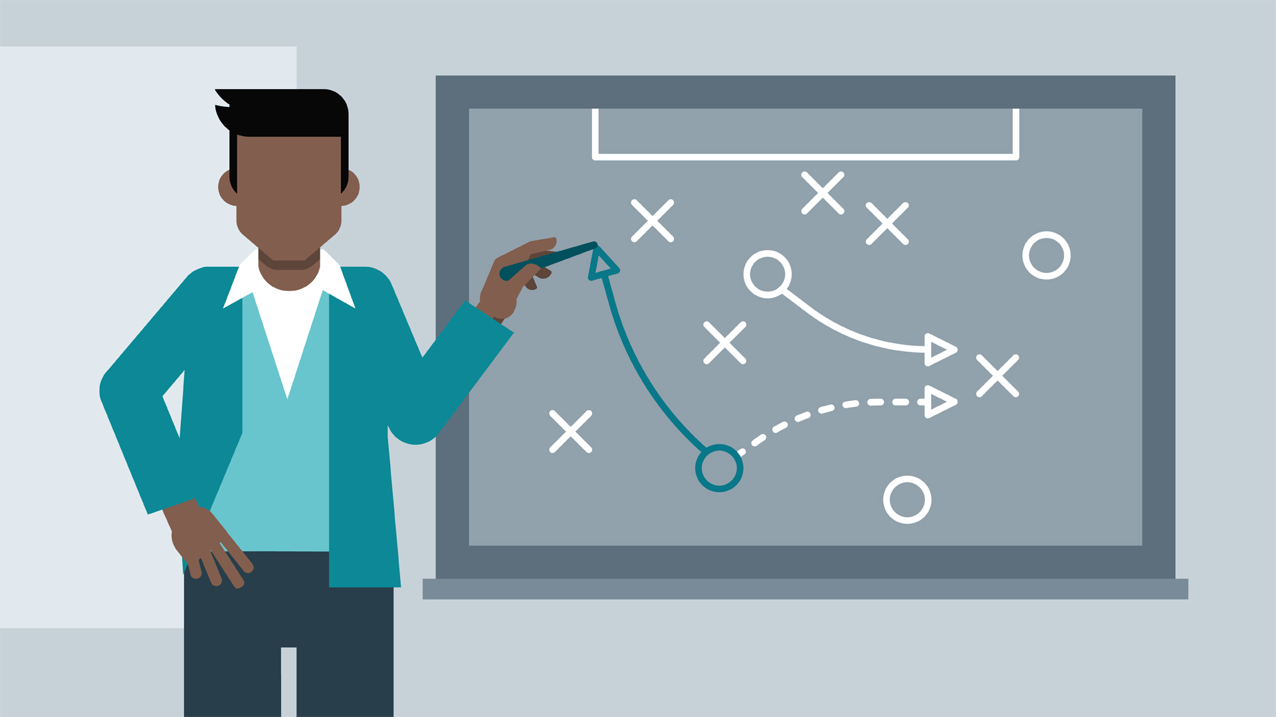
Features That Make The Game Compelling And Unique(Scarcity and Strategy)
This creates an interesting conflict in the player’s mind. Should they play it safe and leave themselves vulnerable or should they invest some of it in equipment to defend themselves?
Players should think ahead when buying weapons as they have durability and will be destroyed if they are used too many times. So, it is important to use items appropriately.

Slide 8
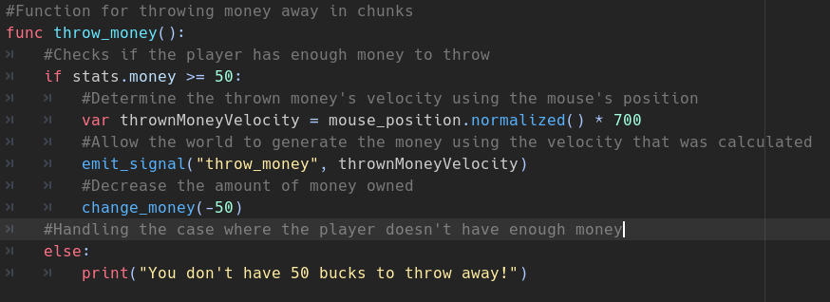
Features That Make The Game Compelling And Unique(Encumberment)
As you gather more money in a stage, you will get slowed down by the weight of the money. If you do not want to get slowed down, you might have to throw some of it away to flee from a dangerous situation which adds another layer of strategy.
We really wanted to incorporate the notion of “High Risk, High Reward” into our game.

Slide 9
Controls During Play
WASD/Arrow Keys – Walking
Mouse position – Decide player's direction
Left click – Attack
Spacebar – Roll
E – Interact with object and people
Q – Use heal item
Escape Key - Pause

Slide 10

Game Mechanics
Can move around in 2D space.
Can't run but can roll to gain extra speed for a while.
You slow down as you gather more money, but you can throw some away.
When approaching an item/person that can be interacted with, an icon will pop up, signifying that they are interactive.
Can steal from people and objects such as safes.
There are collectibles in some stages that gravitate towards the player once they are close enough to it.
Can kill people and destroy certain objects such as security cameras.
Can use melee and ranged weapons.
Can cycle through weapons.
Weapons have durability.
Shops to buy items from.

Slide 11
Game Mechanics - Summary
In summary, A.D.D. exhibits many features found in other top-down 2D shooters but incorporates some that are unique to itself.
It is important for us to express our creativity and make the game even more enjoyable than a typical 2D top-down shooter.

Slide 12
Game AI
All the AI in A.D.D. can be broken down into 2 different types: Passive and Aggressive AI. Both types can be killed by the player.

Slide 13
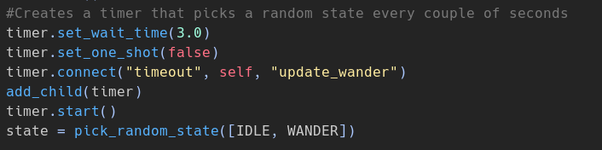
Passive AI
When the player is being a model citizen and not causing trouble, such as attacking or stealing, passive NPCs will randomly switch between their ”IDLE” and ”WANDER” states.
Using a timer with intervals of several seconds, every time it counts down to zero, one of the two states will be chosen, and the timer will be reset.
Shuffling states
Randomise target position to walk to

Slide 14
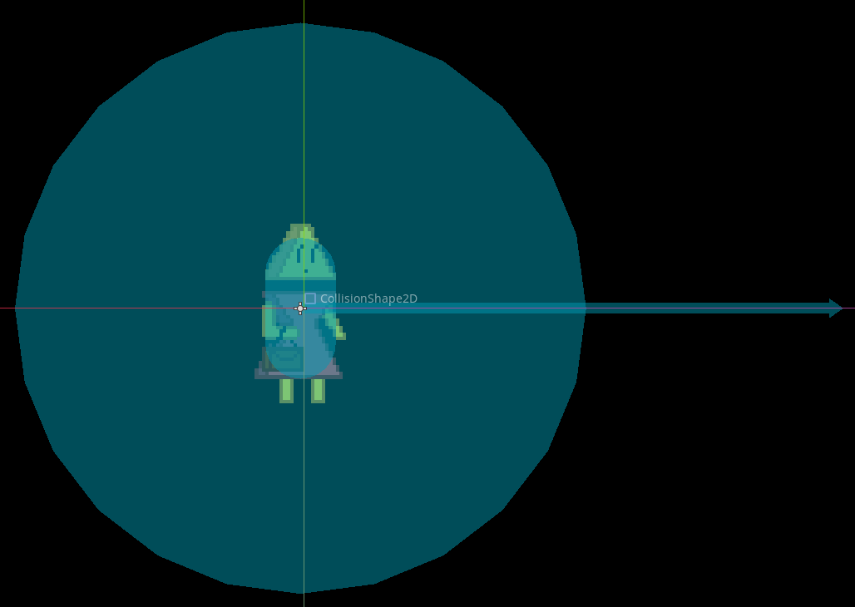
Passive AI
However, if the player is in the NPC’s area of detection while committing crime, their state will flip to ”PANIC”, which will alert the stage that the player has been detected, which will consequently spawn in enemy cops.
If they detect other NPCs panicking, their state will also be set to "PANIC".
For detecting other NPCs
For detecting players. By giving it a direction, players can perform stealth actions while passive NPCs are not "looking".

Slide 15
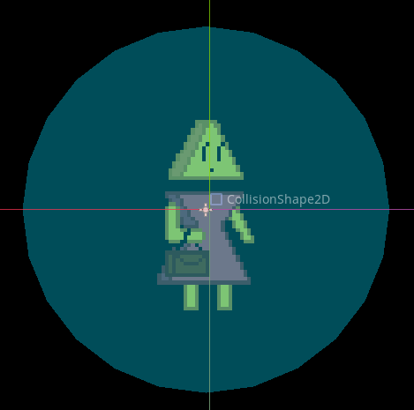
Passive AI
Some NPCs can also be pickpocketed by holding down the "interact" button while in their interactive range.
Separate area that once the player enters, they can start pickpocketing.

Slide 16
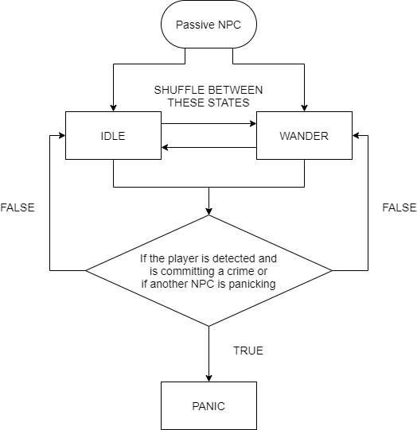
Passive AI

Slide 17
Aggressive AI
Once the world has been alerted of the player’s crimes, cops will spawn and target the player.
They also have an area of detection and if the player is within this area, they will be chased down mercilessly.
If they get close enough to the player, they will start attacking with whatever weapon is in their possession.
If the player manages to escape from their area of detection, the cops’ states will also flip between ”IDLE” and ”WANDER”, looking for the player.

Slide 18
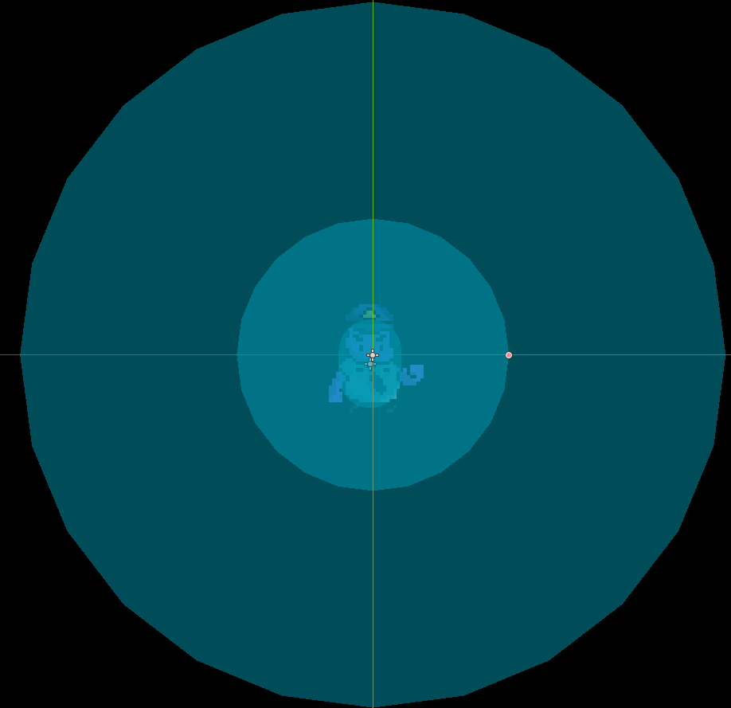
Aggressive AI
Player detection area
When the player enters this area, start attacking

Slide 19
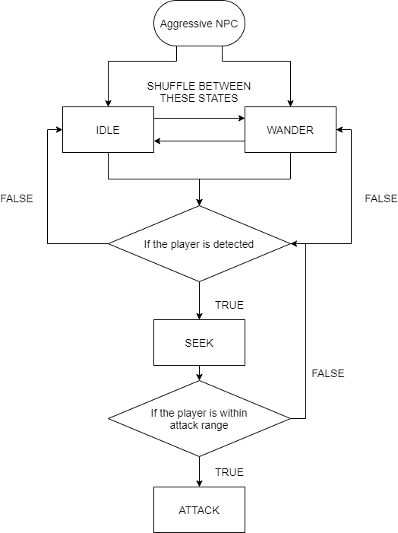
Aggressive AI

Slide 20
Game Elements
Characters 21-29
Player 22
Classy Woman 23
Timmy 24
Police 25-28
Dealer 29
Equipment 30-33
Melee Weapons 32
Ranged Weapons 33
Objects 34-40
Loot That Gravitates Towards The Player 35-36
Decorative Objects 37-38
Security Cameras 39-40
Game Economy 41
Audio 42
Levels 43

Slide 21
Game Elements - Characters
Here are the characters that the player can encounter during their time playing.

Slide 22
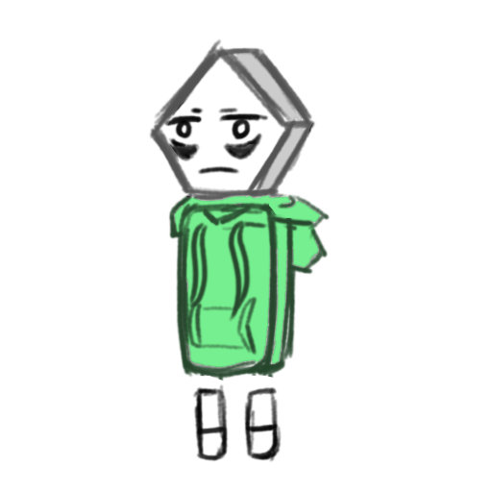
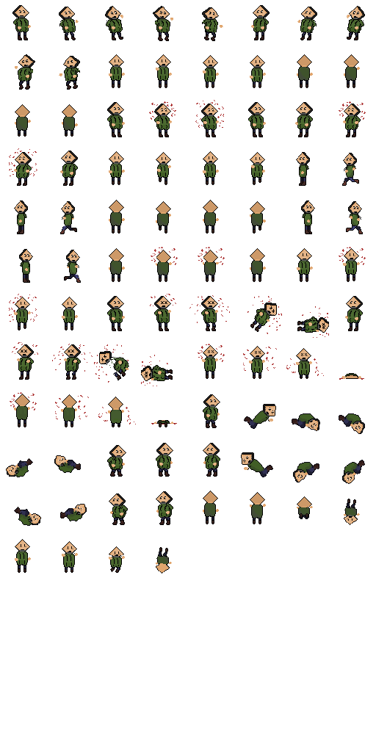
Characters - Player

Slide 23
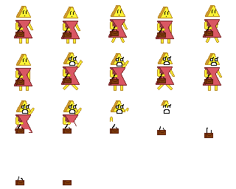
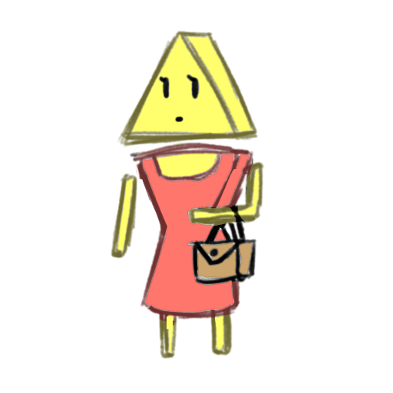
Characters – Classy Woman

Slide 24
Characters - Timmy

Slide 25
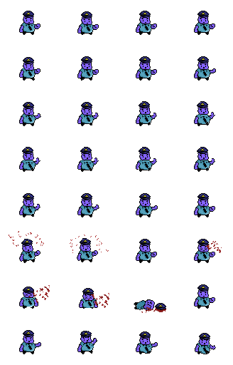
Characters – Police(Default)

Slide 26
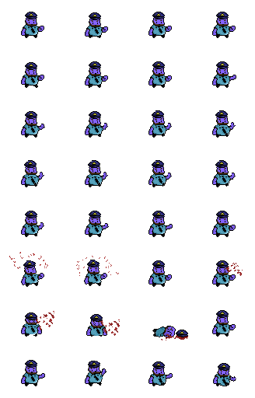
Characters – Police(Beard)

Slide 27
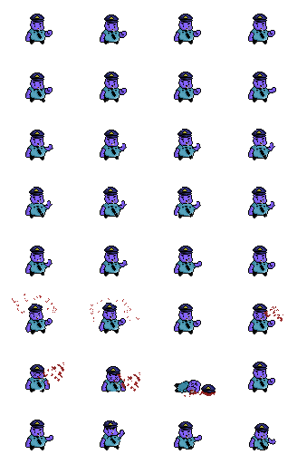
Characters – Police(Smoker)

Slide 28
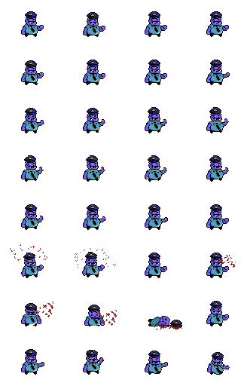
Characters – Police(Sunglasses)

Slide 29
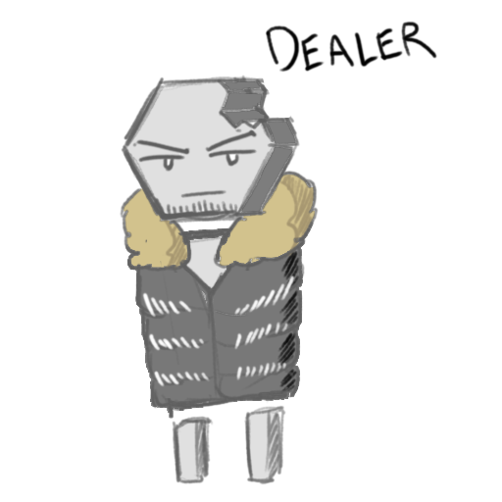
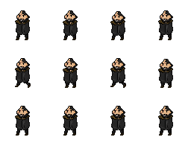
Characters - Dealer

Slide 30
Game Elements - Equipment
Modular, portable
Every player and NPC should be able to equip any weapon. All they must do is to call its individual “attack” function to activate it.
Position will be constrained to a radius around the user, allowing 360 degrees of freedom.
Every weapon will have animations that play when they are used.
Weapons can either have 4 variations of sprites it can flip between based on whether it’s facing up, down, left or right or 2 variations by rotating the sprite within the game engine and flipping horizontally/vertically as needed.

Slide 31
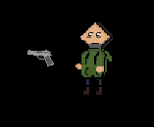
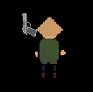
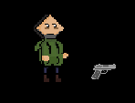
Game Elements - Equipment
All weapons will be constrained to a radius around the character.
For the player, the weapon can be moved using the mouse's position.

Slide 32
Equipment – Melee Weapons
Variables
Durability, max_durability
Attack function
Play the attack animation and appropriate sound effects.
Durability function
Call decrease_durability if the player is using the weapon on an NPC.
If the durability goes to 0 or below, remove it and play a broken effect to signify to the player that it is broken.

Slide 33
Equipment – Ranged Weapons
Variables
AmmoCount, bulletSpeed
Attack function
Same as the melee weapons except this time, if there is ammo left, generate an instance of a bullet and give it a velocity that’s determined by the ranged weapon’s bulletSpeed variable.
Ammo
Instead of durability, call a decrease_ammo_count function to decrement ammoCount. Unlike melee weapons, ranged weapons won’t get destroyed. They will just become unusable once they run out of ammo.
For the ammo, it contains a hitbox area that will deal damage once it enters a hurtbox. When it hits any collision body(including walls), it will be deleted.

Slide 34
Game Elements - Objects
Here are the items and objects that the player can encounter during their time playing.

Slide 35






Objects – Loot That Gravitates Towards The Player

Slide 36
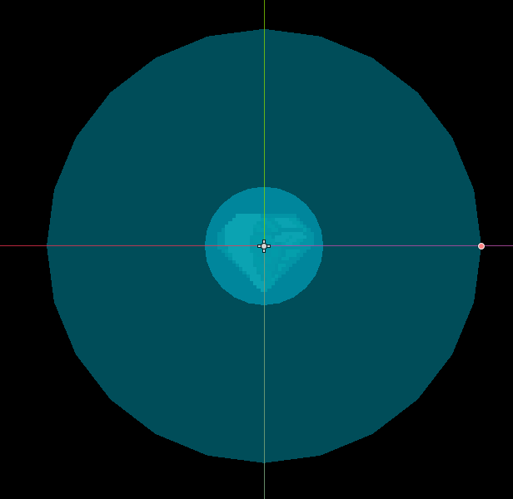
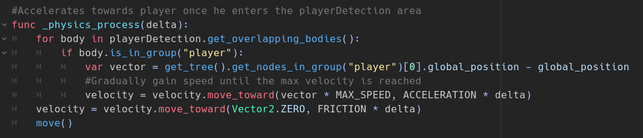
Objects – Loot That Gravitates Towards The Player
Trigger collect area
Player detection area
How the item can move towards the player:

Slide 37
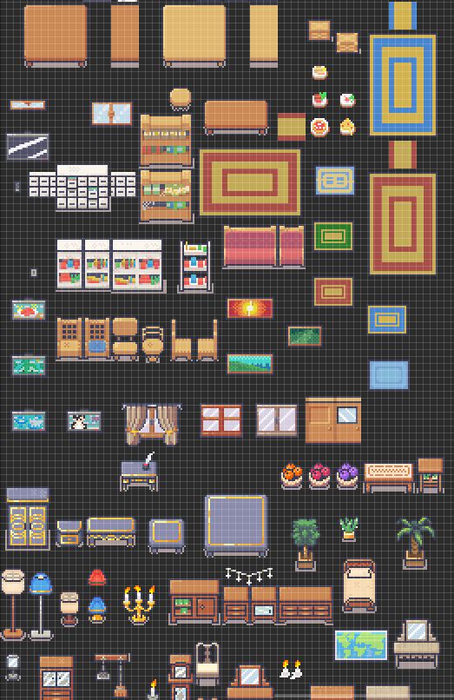
Objects – Decorative Objects

Slide 38
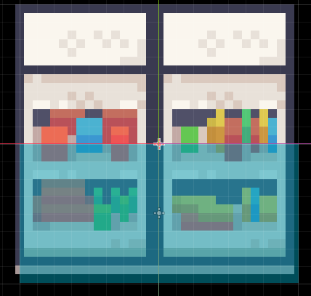
Objects – Decorative Objects
Since most of these objects are just for decoration, it’s fine to just give them collision shapes as necessary so that the player can't go through them.
However, some might have extra functionalities such as doors and safes containing money that can be robbed.
Collision

Slide 39
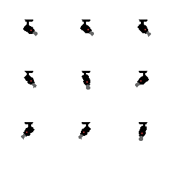
Objects – Security Cameras

Slide 40
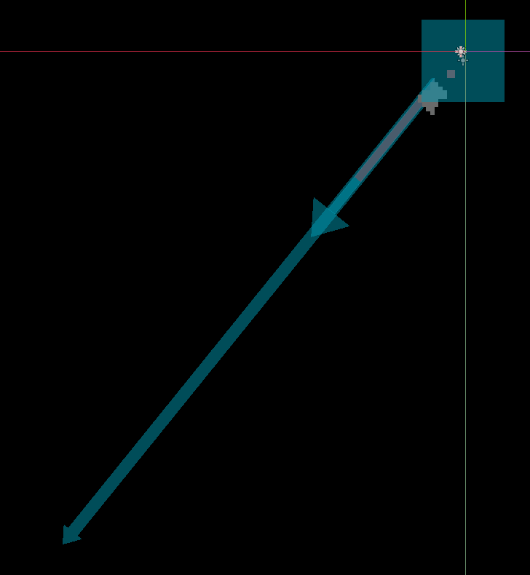
Objects – Security Cameras
Like NPCs, cameras also have health and will be destroyed once its HP reaches 0.
The laser coming out of the camera should be blocked by bodies such as walls.
If the player is detected while committing crimes, start spawning cops.
Body and hurtbox
Ray that detects player

Slide 41
Game Elements - Game Economy and Statistics
This link will send you to our Github repository, where you will find an Excel sheet documenting stats of levels, characters and items.
Developers should maintain a good balance to ensure fair and fun gameplay.

Slide 42
Game Elements - Audio
Sound effects needed:
Walking, hurt and death sounds for every character.
Rolling sound for the player.
Attacking and breaking sounds for every weapon.
Whirring sound for the security camera.
Sounds for UI elements such as buttons and selecting items in the loadout screen.
An alert sound for when the world is aware of the player's crime, warning them at the cops are coming.
Music needed:
To fit the theme of the game, music containing rap beats would be appropriate as it adds intensity.
Incorporate some calmer music for moments such as accessing the loadout screen. This helps the player focus as they choose their weapons.

Slide 43
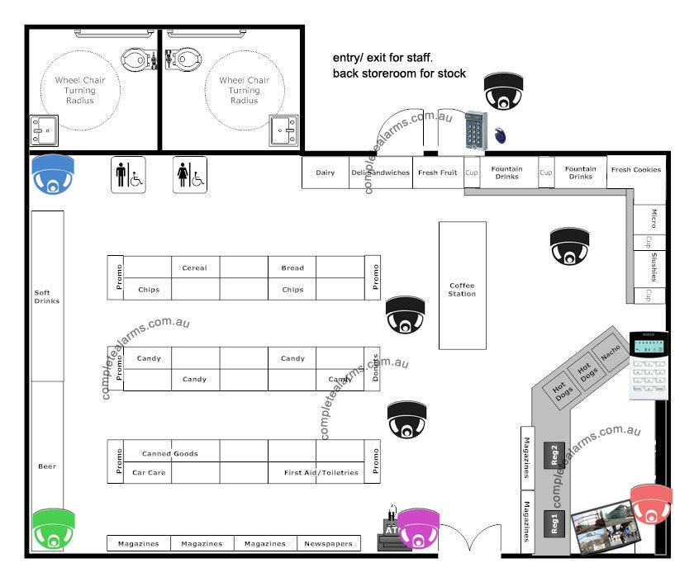
Game Elements - Levels
At the minimum, there should be a convenience store level. This will act as an introductory level for the player to get comfortable with the mechanics.
After making the convenience store level, developers can move on to bank and jewelry store levels.
Existing floor plans can be useful as inspiration.

Slide 44
Game Progression(1)
Initially the player starts off with just his fists, which do minimal damage to enemies.
This helps encourage stealth as a full-frontal assault is not recommended with no equipment.

Slide 45
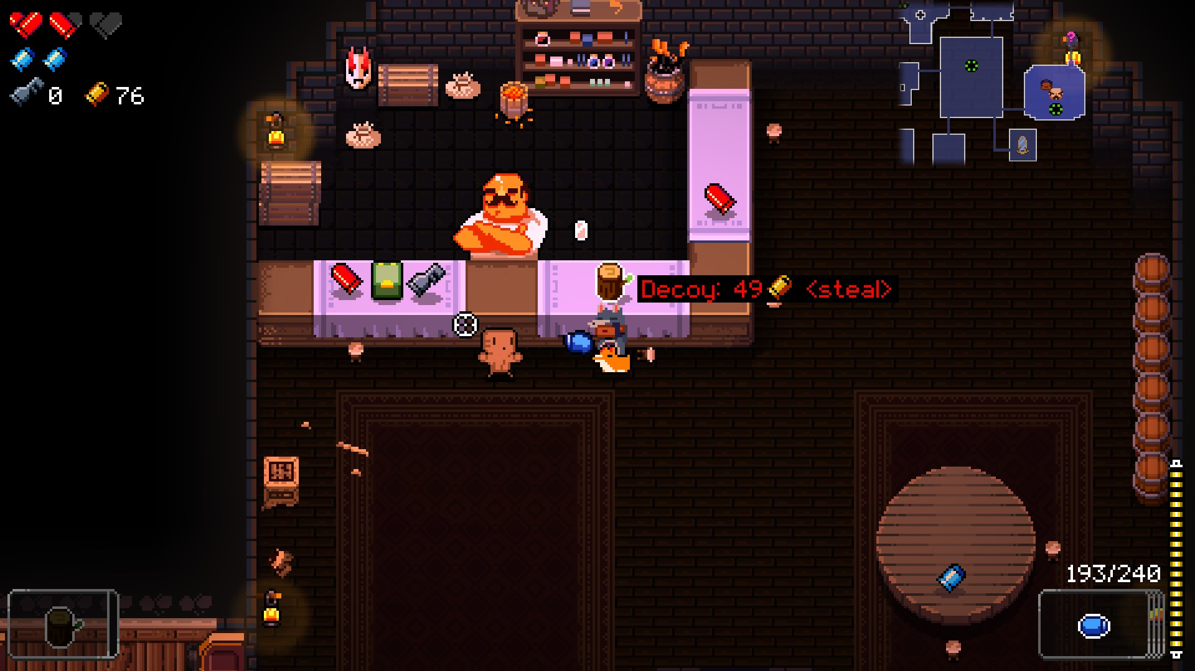

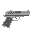

Game Progression(2)
After the first heist, “The Player” unlocks the shop, a sort of hub where items and weapons can be purchased from “The Dealer”. These weapons include guns and knives.
Other items include med-packs that can be used mid-session to restore some health.
Inspirations can be taken from games such as "Enter the Gungeon".

Slide 46
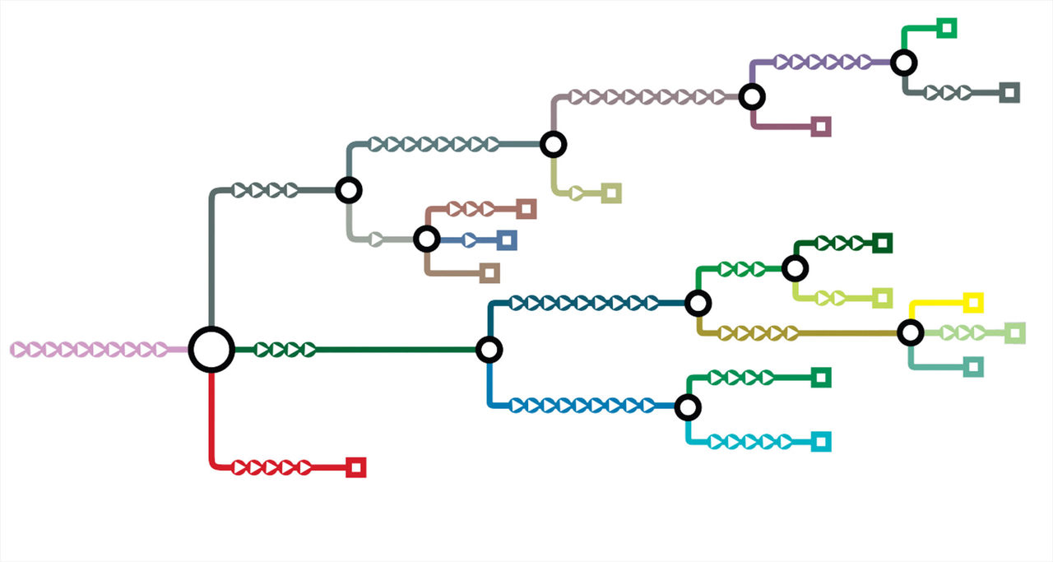
Game Progression(3)
All of these are purchased with the money and collectibles stolen from the heists. These collectibles come in the form of gems, gold bars, coins, and cash that the player collects by walking over them during the heist.
These items and weapons make gameplay more varied as the number of approaches multiply exponentially. “The Player” must carefully balance buying upgrades to help him earn more money with the task of saving his money in-order-to pay back Starman.

Slide 47
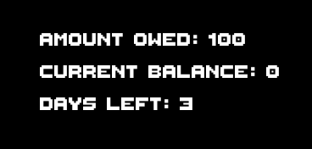
Win Loss Conditions
From day 1, the player is shown a dramatic screen showing how much money they have, how much is owed and how many days is left to pay it off.
Every time they exit a stage or get defeated by the police; days will pass.
Once the deadline comes, it checks if the player has enough money.
If they have enough, they win! If they don't, it's game over.

Slide 48

System Menus
While designing the various system menus in A.D.D., we do not want to distract the player with copious amounts of unnecessary menus.
Every menu must be as snappy and quick as possible.
We want the focus to be on the gameplay, to minimize the overall time spent in menus as much as possible so that our player gets as much entertainment by playing the game.

Slide 49
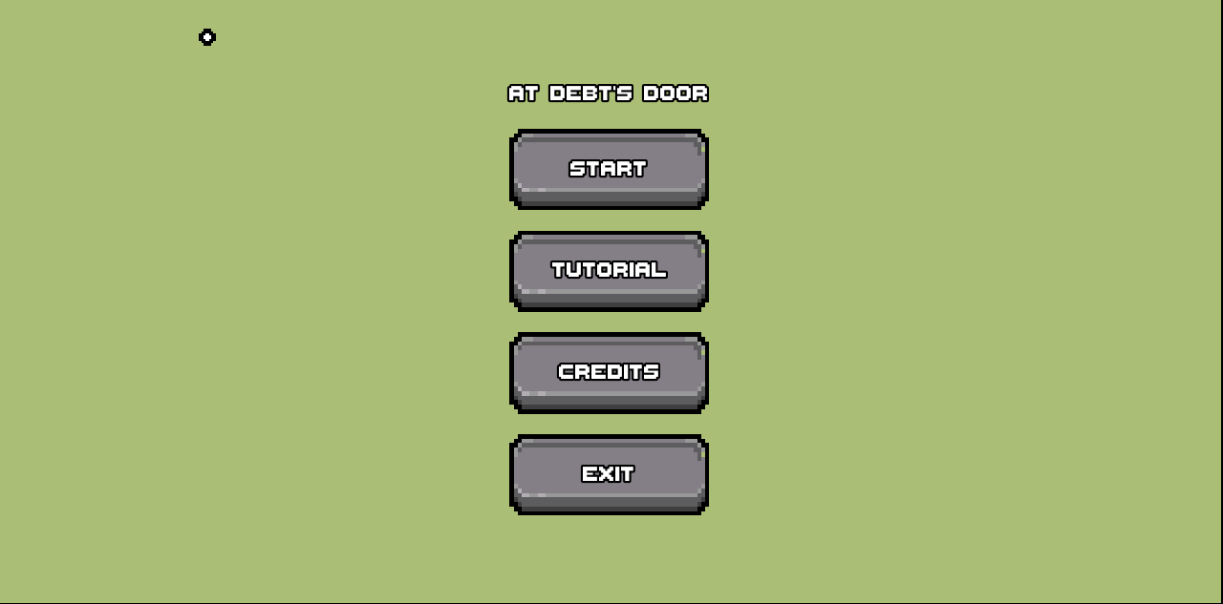
System Menus – Main Menu
In the main menu, buttons for “START”, “TUTORIAL”, “CREDITS” and “EXIT” are present against a cinematic illustration. We want to make this visually pleasing.

Slide 50
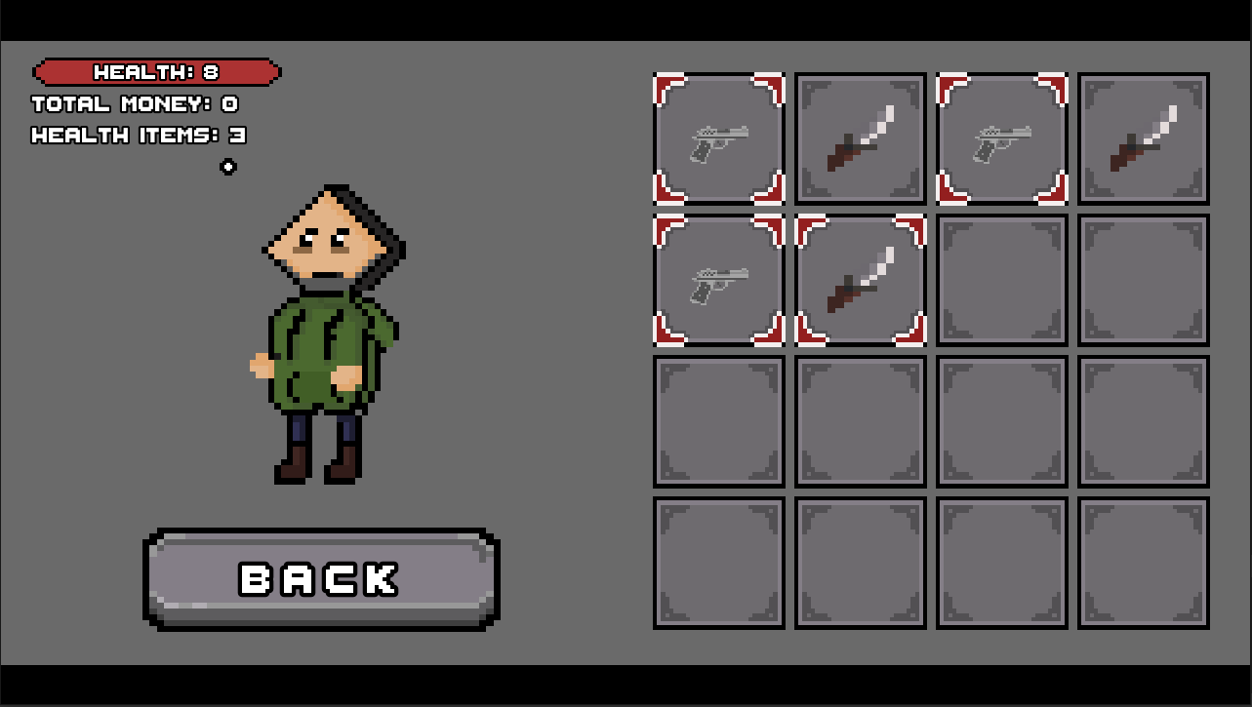
System Menus – Loadout Screen
There is a loadout menu in which you can equip/unequip your weapons. A 4 x 4 grid inventory is shown on the right with the player’s avatar standing on the left. The ”BACK” button is placed below the player and when it is pressed, it will send you back to the main game.
The inventory shows every weapon that you have in your arsenal and currently equipped weapons will be visually marked with a border. To equip/unequip an item, players simply click on them.

Slide 51
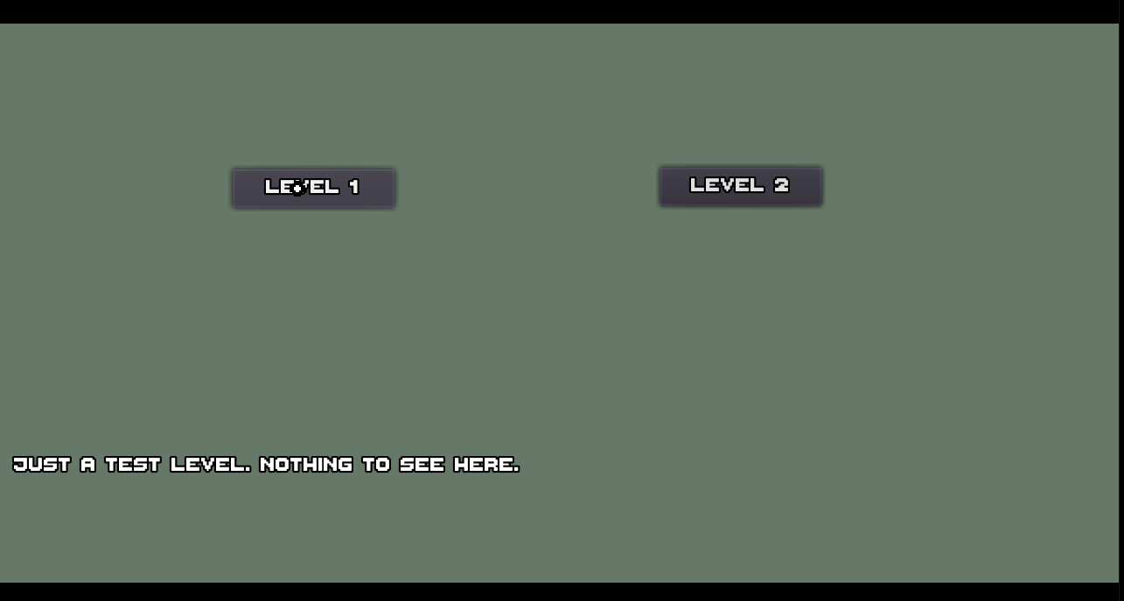
System Menus – Map Selection Screen
In the map selection screen, players will see icons of various stages and shops that are available to them. By hovering over each icon, text will show up at the bottom of the screen, giving info about the stage such as how much loot is potentially available and potentially how dangerous it might be.
It is important to us that the player is aware of the challenge ahead. We want our players to know what they are getting themselves into when starting a new level.

Slide 52
Game Design Plan – Roles Needed
Programmer
Game tester
Art Director
Audio Director
UI Director
Level designer
Marketing staff

Slide 53
Game Design Plan – Production(1)
Total production time: 180 – 200 hours.
Operations can be pipelined and carried out in parallel.
100-110 hours go into coding and the programmer can start straight away, using default textures and bodies to add fundamental features.
Quickly make a test level to test various features.
While the programmer is at work, art and music directors can start on getting assets. One by one, the programmer can drop in the textures/audio and set up animation states and audio managers.

Slide 54
Game Design Plan – Production(2)
For every feature that the programmer adds, they will rigorously put it through many simulations and find as many bugs as they can.
For example, when creating characters with AI, they should be tested to their limits. Is the game stable no matter where they are placed? How about when 50 of them are loaded in a single level?
UI Director can also start the design of every screen and icon. Communicate with the art and music director for assets. Talk to the programmer about how to link different screens together.
Meanwhile, the level designer can plan out levels knowing what objects and game elements will be available.(Characters, loot, security camera)

Slide 55
Game Design Plan – Production(3)
Once most of the features are done at around the 90-100 hour mark, level designer can work with the programmer in assembling levels.
Towards the end, the marketing team will start to advertise and promote the game, knowing that the features are mostly finished. They will set a realistic release date for the development team to target.
Afterwards, everyone will test, fix bugs, provide feedback and tweak various parameters in the game until the release date arrives.

Slide 56
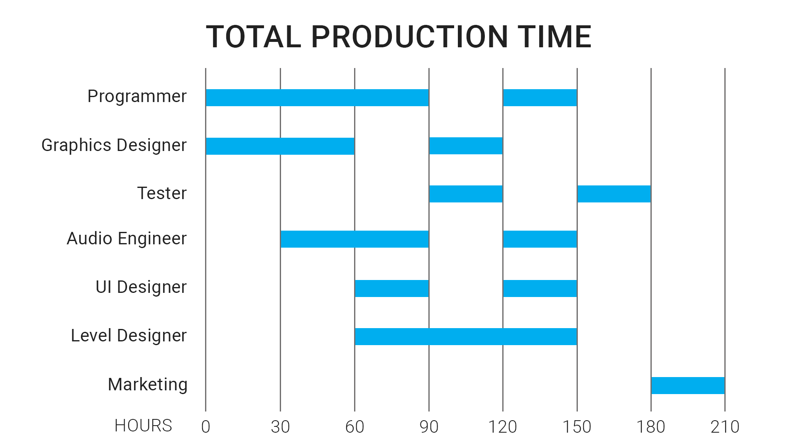
Game Design Plan – Production(Visual Representation)

Slide 57
Postproduction
Postproduction is just as important as the production of the game as it is what will help spread awareness about our game.

Slide 58
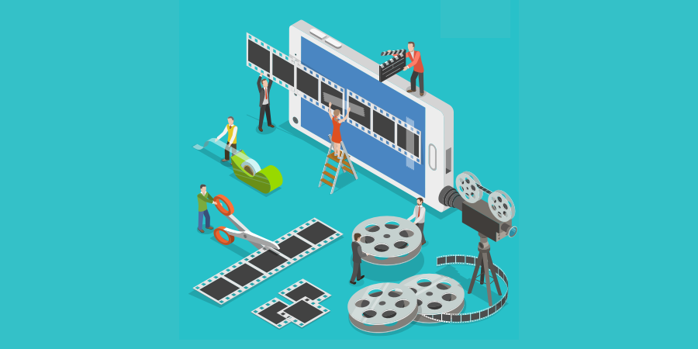
Postproduction - Marketing(Trailers)
Firstly, a trailer should be created in order to raise excitement for the game. Time and effort should be taken in crafting the artwork for this short trailer as it is the first chance for audiences to be interested.

Slide 59


Postproduction - Marketing(Sponsorships)
In order to promote the completed A.D.D, free codes and a sponsorship would be provided to popular Twitch Streamers and Youtubers in order to raise awareness of the game.
The exposure it would create would really boost sales of the game and be an overall benefit to the A.D.D community. A large community improves the lifespan of the game and helps the possibility of a sequel.

Slide 60
Conclusion
Completing A.D.D. is a vigorous process. It takes a lot of time and dedication to create all the assets, mechanics, ideas and everything else that is needed for a fully playable version of A.D.D.
We believe that this idea when done correctly, can be popular, very fun to play and successful. Building this project from the ground up can be challenging but once all the mechanics of the game that are essential for the player are fully stable, developers can focus on level design and polish.
This game is theoretically infinitely expandable as newer levels can be created whenever the ability to do so is there. This keeps the game fresh and keeps bringing the players that love the game back for more and potentially new players.
Every step outlined in this document is essential to be completed correctly. For example, if our ideas for postproduction are not applied correctly this whole project has a bigger chance of never taking off and essentially failing.
We believe that if this project is done properly, it can be profitable. For example, we can offer the ability to purchase our currency for money thus giving the player the ability to buy powerful items in the store faster.

Slide 61
References
The Github repository: https://github.com/TheCaister/At-Debts-Door-Document

